Slide 1
Reducing dimensionality with principal components
MCB 288 Lecture 3 26 January 2022

Slide 2
General problem
Last time: linear regression: y depends on x (or maybe x₁, x₂, x₃ …)
We often encounter a general problem:
A large number of variables x₁, x₂, x₃, … that are not independent of each other
Example: BMI and blood pressure in diabetes example.
But also:
in gene expression studies, many genes belong to groups that are coordinately expressed (e.g., those coding proteins of the ribosome).
So the ”information” in the expression levels of N=6000 yeast genes or N=15,000 fly genes is really contained in far fewer numbers (maybe one for each “module”)

Slide 3
Another example:
Genetic variation among individuals
Each variable locus in genome has two alleles, call them “0” and “1”
Three possible genotypes
“0/0” – encode this as “0”
“0/1” – encode this as “1”
”1/1” – encode this as “2”
Note this is discrete, but has a very high dimension (since current arrays determine genotype at 1 million sites).
Some sites have low alt allele frequency and are mostly 0/0 with some 0/1, so have low variance.
Some sites have alleles that are more common in specific populations. Each individual site may have a small difference in allele frequency between populations, but many sites may be correlated with

Slide 4
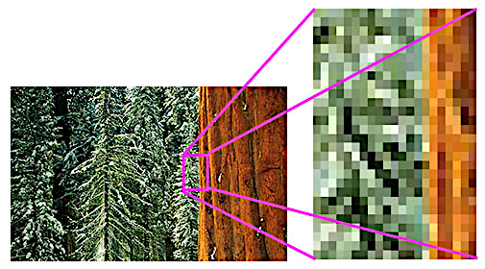

Another example:
Images = large two-dimensional array of intensities (e.g., 0…256; maybe three numbers per pixel for colors)
https://en.wikipedia.org/wiki/Pixel
https://www.ultimate-photo-tips.com/what-is-a-pixel.html

Slide 5
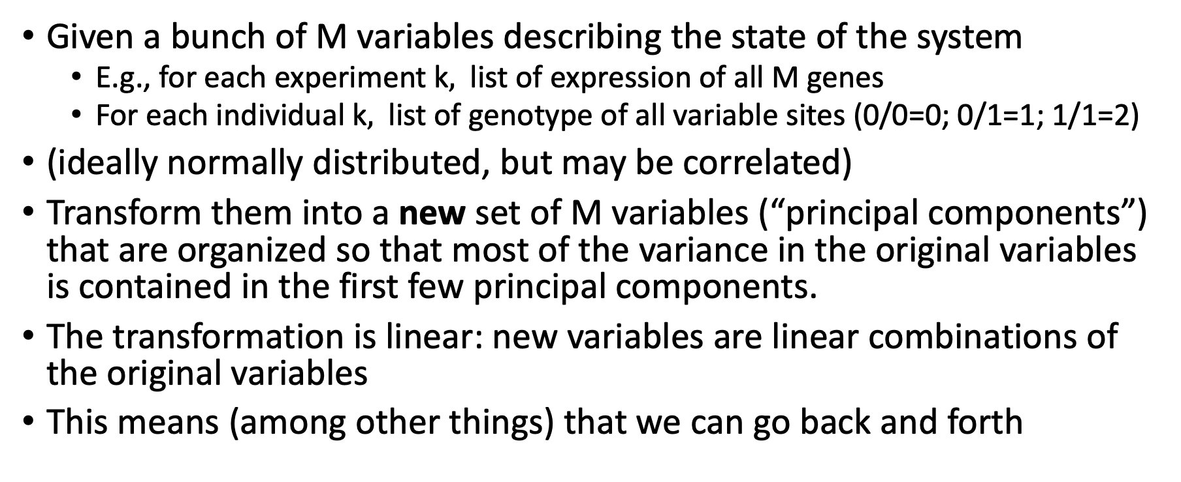
Principal component analysis
Given a bunch of M variables describing the state of the system
E.g., for each experiment k$,$ list of expression of all M genes
For each individual k$,$ list of genotype of all variable sites (0/0=0; 0/1=1; 1/1=2)
(ideally normally distributed, but may be correlated)
Transform them into a new set of M variables (“principal components”) that are organized so that most of the variance in the original variables is contained in the first few principal components.
The transformation is linear: new variables are linear combinations of the original variables
This means (among other things) that we can go back and forth

Slide 6
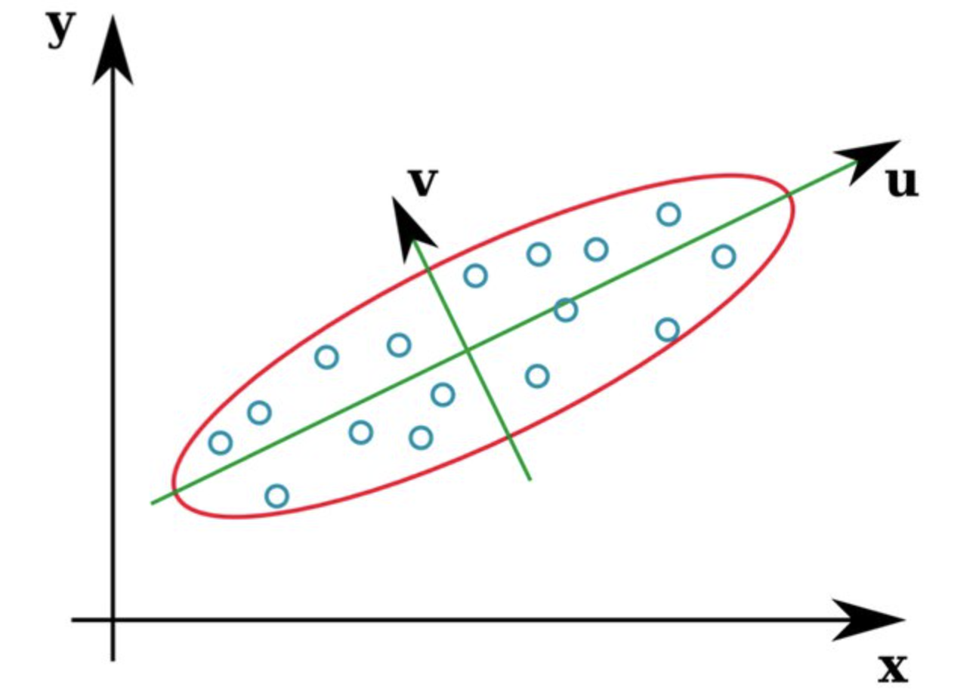
“Eigenvectors” = natural axes of a (covariance) matrix
Cov * u = A * u
Cov * v = B * v

Slide 7
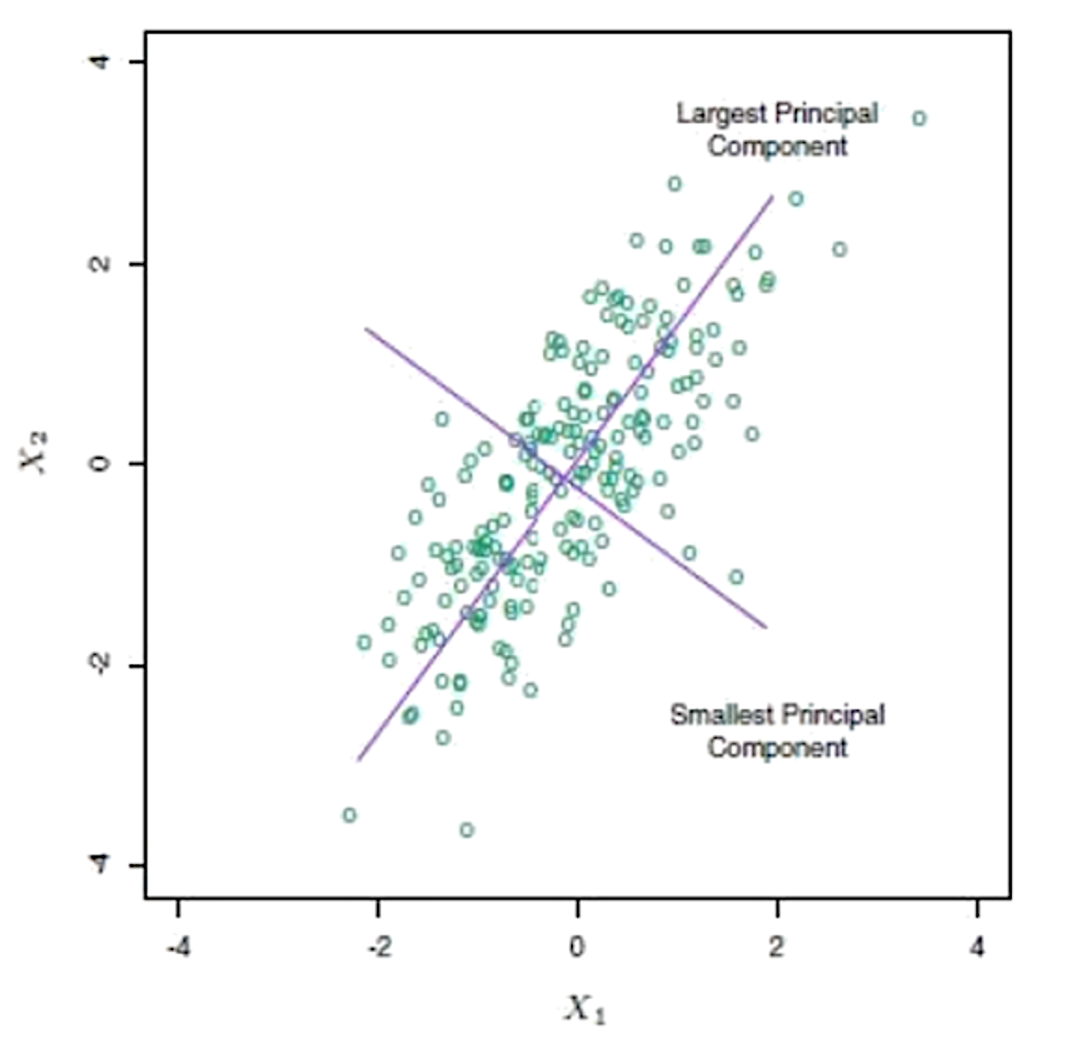
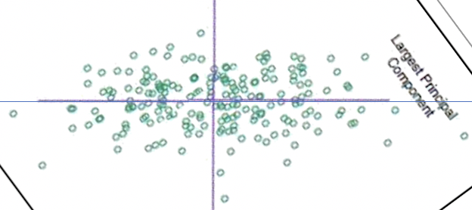
Simplest example: two correlated variables
Rotate so that the new x-axis aligns with the direction of most co-variance
Stretch so that each of the new axes has the same variance.

Slide 8
Simplest example: two correlated variables
“First” principal component = a*x1 + b*x2
Where a and b are chosen to account for the most overall variance in the data
“Second” principal component = b*x1 - a*x2
Perpendicular to the first component, so that variation in second component is independent of the first

Slide 9
Under the hood …
Compute the Covariance matrix between all the original variables
Linear transformation = eigenvector decomposition
Can be done progressively:
Find the values a, b, c, d, …. that maximize the variance of
PC₁ = a*x₁ + b*x₂ + c*x₃ …
The remaining N-1 dimensions have no covariance with PCA₁.
Repeat to get PC₂, PC₃, … until all remaining dimensions are exhausted.
Note: shifting each variable by a constant offset doesn’t have an effect, since covariance is about differences from the mean. Data will be centered automatically.
Each PC accounts for some fraction of the total original variance.

Slide 10
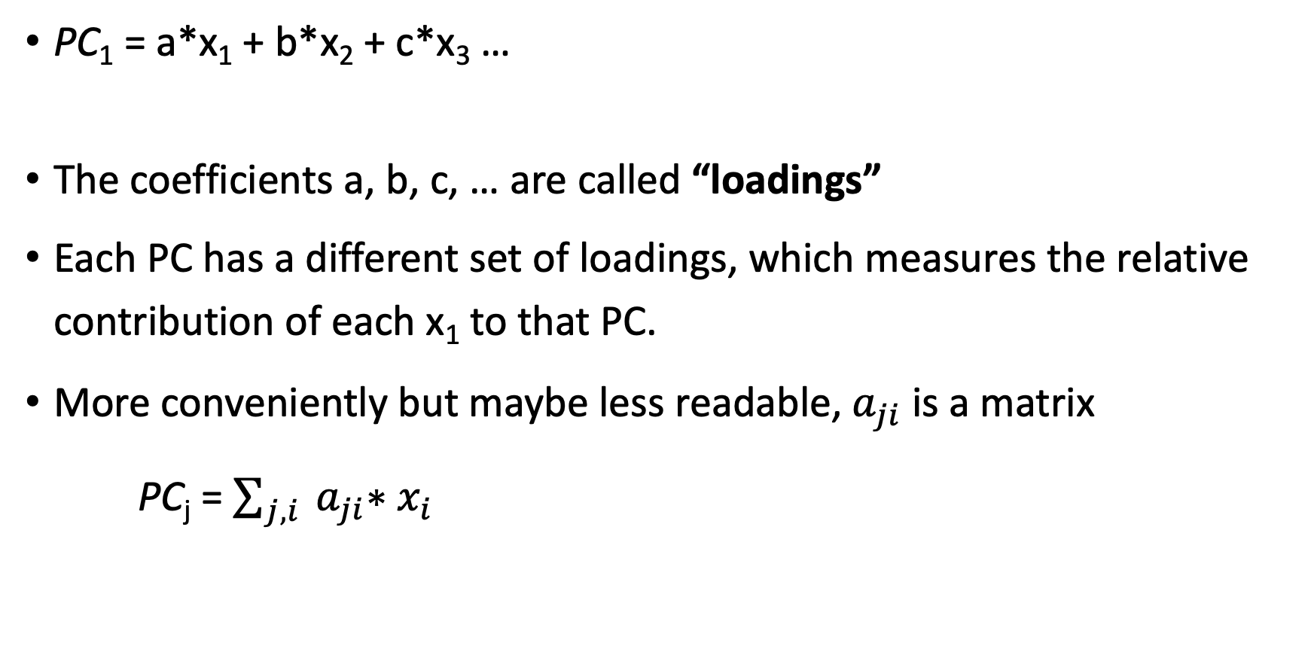
Jargon
PC₁ = a*x₁ + b*x₂ + c*x₃ …
The coefficients a, b, c, … are called “loadings”
Each PC has a different set of loadings, which measures the relative contribution of each x₁ to that PC.
More conveniently but maybe less readable,${ a}_{ji}$ is a matrix
PC_{j} = $\sum_{j,i}{{ a}_{ji}∗x_{i} }$

Slide 11
Each principal component represents some fraction of the total variance
If we keep only PC1, then we are essentially setting all the other coordinates to zero.
This is like collapsing data from the other directions onto the purple line.
Keeps a fraction of the total original variance (which is reported by the software)
[compare with our discussion of “variance explained” in linear regression.]

Slide 12
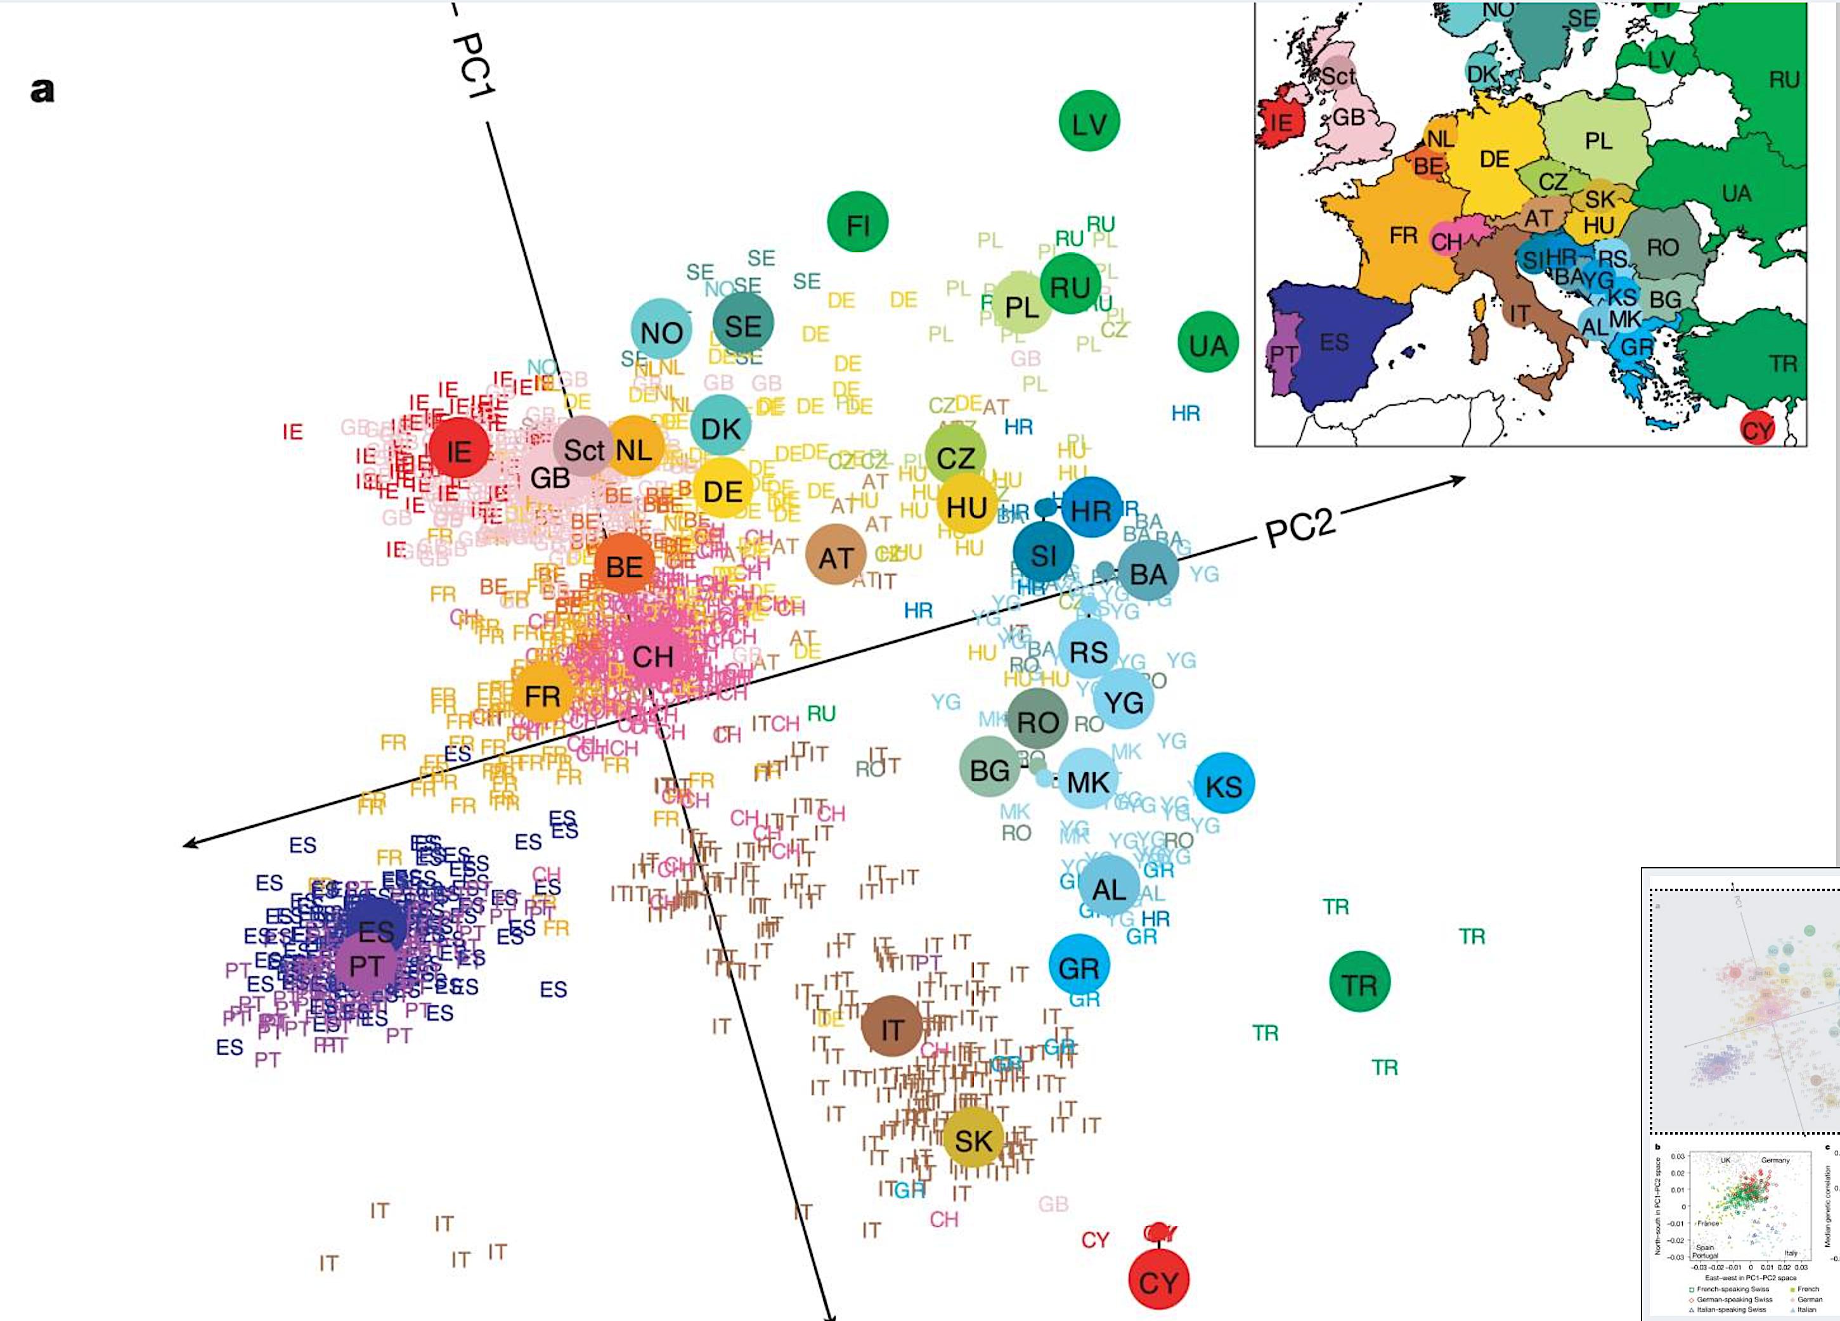
“Genes mirror geography” Novembre et al., Nature, 2008

Slide 13
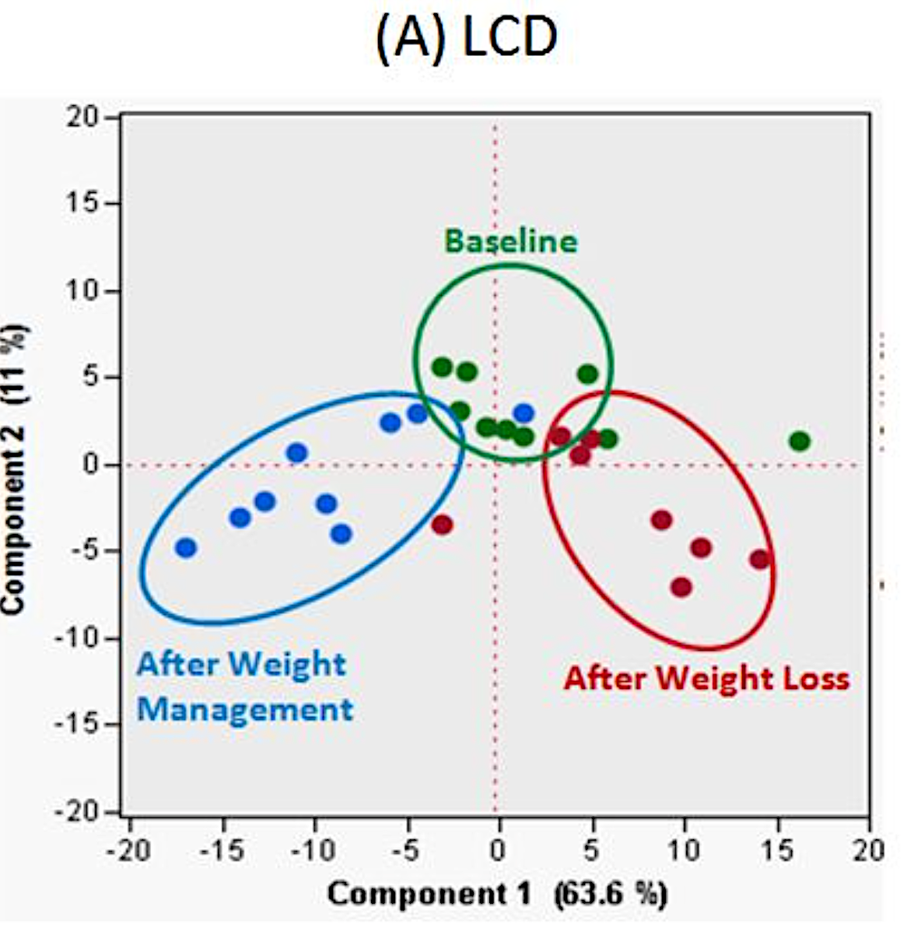
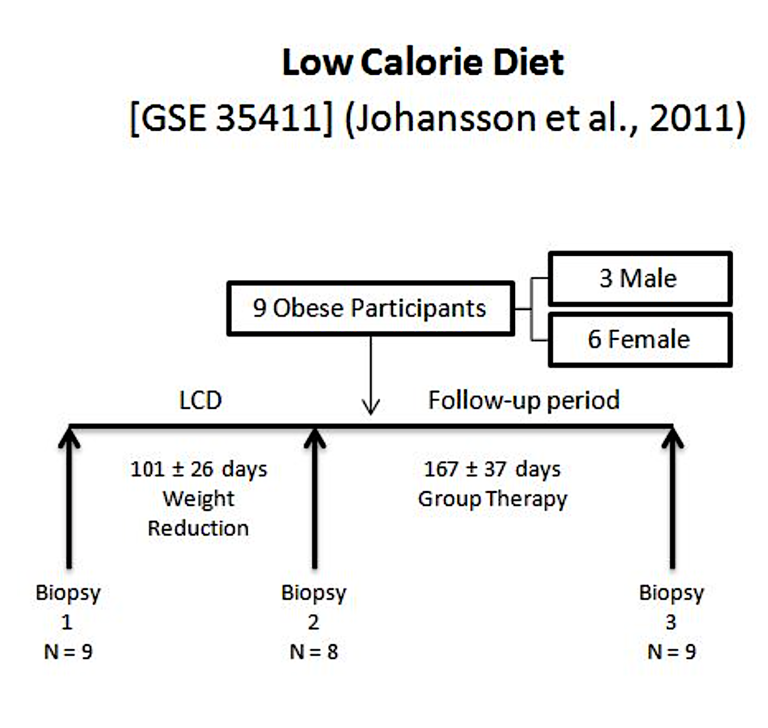
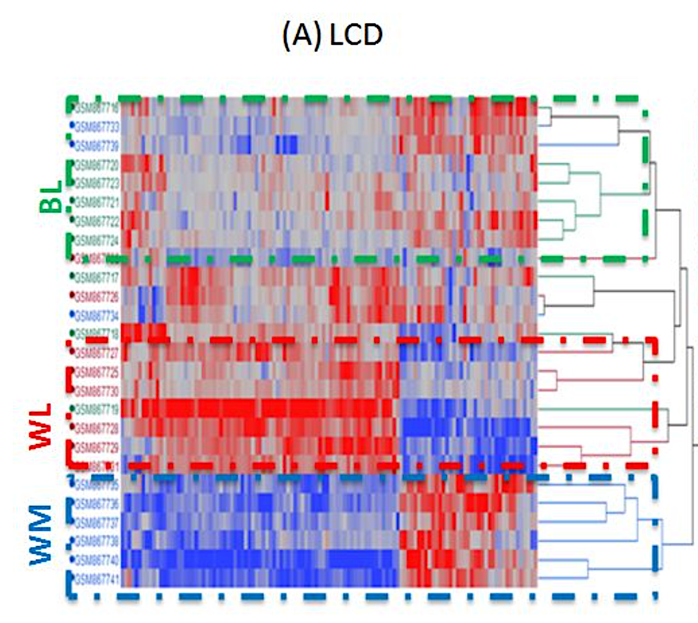
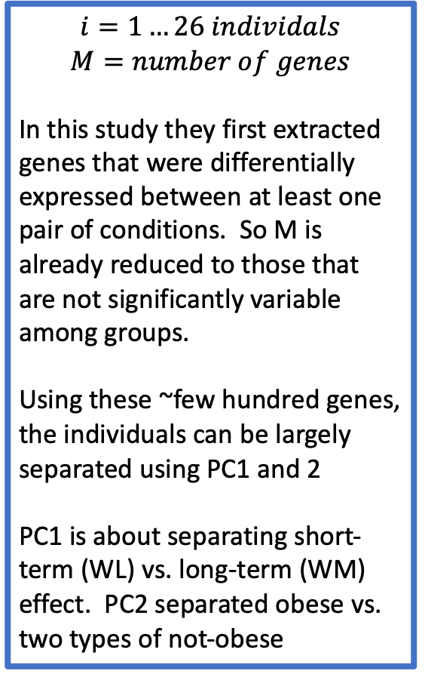
Gene expression in adipose tissue of initially obese individuals before and after weight loss, and after long-term weight management with low calorie diet (LCD)
$$i=1…26 individals$$
$$M=number of genes$$
In this study they first extracted genes that were differentially expressed between at least one pair of conditions. So M is already reduced to those that are not significantly variable among groups.
Using these ~few hundred genes, the individuals can be largely separated using PC1 and 2
PC1 is about separating short-term (WL) vs. long-term (WM) effect. PC2 separated obese vs. two types of not-obese
Group project for course at Georgia Tech. https://gtbinf.wordpress.com/2012/10/19/differential-gene-expression-in-adipose-tissue-as-an-effect-of-dietary-changes/

Slide 14
Can also be used as a noise-filtering process with high-dimensional data
PC₁ = a*x₁ + b*x₂ + c*x₃ ….
If x₁, x₂, x₃, … are driven by a few underlying control variables, but each have their own independent noise, then PCA has the effect of averaging over this noise.
Assumes:
Major source of variation is due to a relatively small number of “signals” that are extracted by first few PCs.
Remaining variation is random uncorrelated noise.
(We’ll see example of this in the workbook)

Slide 15
Summary
Principal components is a way of partitioning the variance in a high-dimensional data by linear combinations of the original dataset
It amounts to rotation/stretching of the data, and is just another way of rewriting the original dataset (no loss of information)
But often the first few (or even few hundred) PC’s contain most of the variation in the dataset, and the remainder can be considered “noise” (or at least less important signal for explaining variance in data)
Loadings can focus your attention on combinations of original data variables that are correlated.
Often a starting point for working with high dimensional datasets. “Dimension reduction”

